Slide 2
Professional Driver Training Uganda Project presentation
Mukono 30.08.2017

Slide 3
Project Objective
Build up heavy goods vehicle (HGV) and passenger service vehicle (PSV) driver training in Uganda in cooperation with industry partners, leading to increased employment of Ugandan drivers in the transport sector and to improved road safety in Uganda

Slide 4
Country Context
Amongst existing driving schools there is no standardised training either in terms of methods used or training content. The practical training available as a proportion of the total training differs hugely between schools and quality is poor
A lack of enforced national mandatory minimum standards has led to a low demand for HGV and PSV training which in turn has hampered training providers’ ability to invest in their own training schools
Currently Uganda has only two instructors licensed by the Ministry of Works & Transport to conduct training for CH class (heavy truck)

Slide 5
Country Context (continued)
A developing oil and gas sector and other infrastructure development projects present an opportunity whereby employment opportunities for Ugandans will increase substantially in the coming years
Key to creating demand and in turn a thriving Large Commercial Vehicle (LCV) driver training sector, this project expects the Ugandan government to adopt standards as set by the EAC standardised curriculum during the lifetime of the project (ending August 2019).

Slide 6
Project Components include:
Developing a new HGV focused driving school to be managed by Safe Way Right Way
The establishment of an interim training facility (until such time as a permanent training centre can be developed)
Training 12 trainers to deliver the EAC Standardised Curriculum
Supporting a number of other driving schools through training their instructors and ensuring consistent training quality
Training 800 drivers according to the EAC Standardised Curriculum
Getting 600 trained drivers into jobs
Advocating for the early adoption of the EAC Standardised Curriculum

Slide 7
Project Partner Roles
Project Funding
Project Steering and Supervision
Quality Assurance
Monitoring and Evaluation
Linkage to Ministry of Energy and Mineral Development

Slide 8
Project Partner Roles
Project Implementation
Oversight of Technical Direction of Project
Financial and Progress Reporting
Line Management of Transaid Advisors
Monitoring, Evaluation & Learning

Slide 9
Project Partner Roles
Management of Training Facility
Private Sector Representation (Member Companies)
Advocacy work
Line Management of Training Facility Staff
Media Campaign/PR
Provision of training vehicles, facilities etc.

Slide 10
Achievements until today

Slide 11
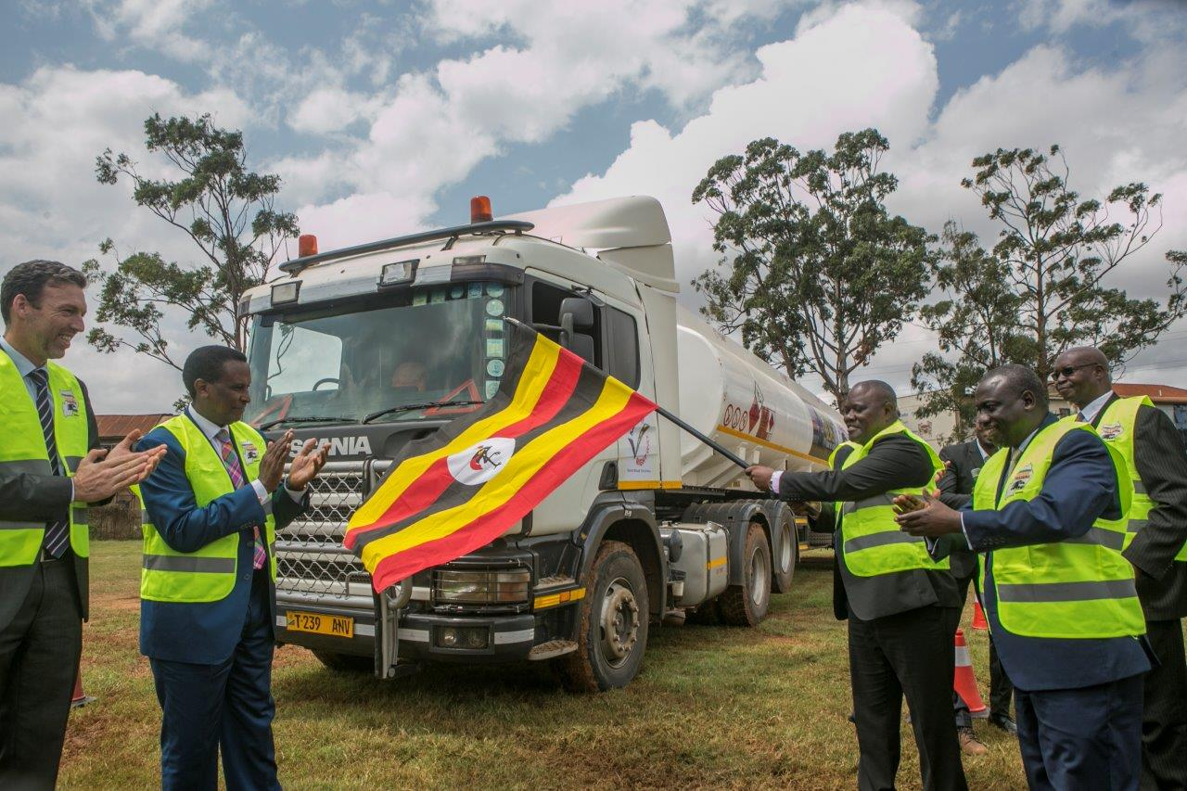
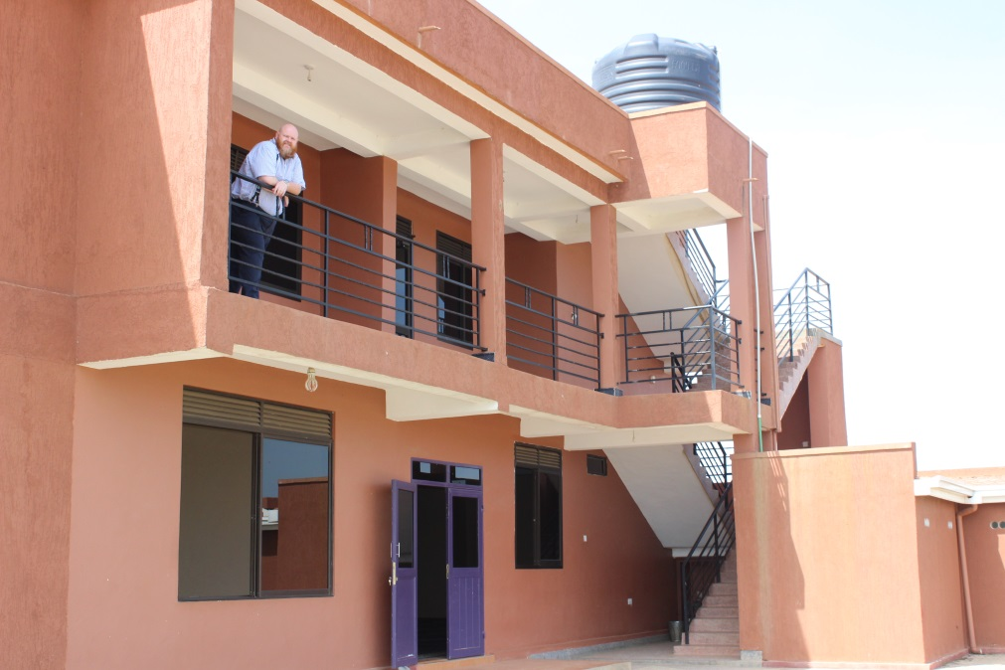
Establishment of an interim training facility
Long term allocation of office and training space
Long term loan of rigid and articulate truck
Centre management and training consultants hired

Slide 12
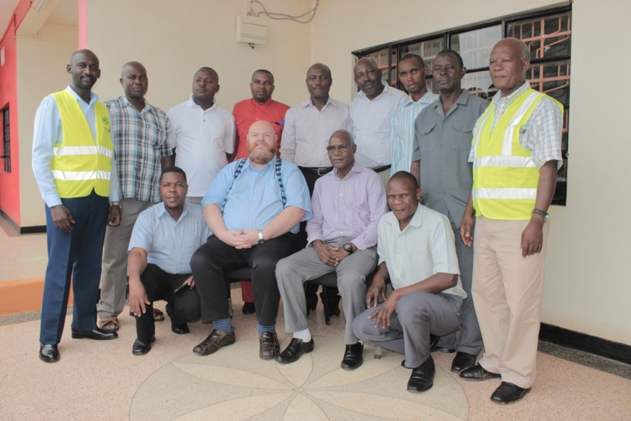
10 trainers trained to deliver the EAC Standardised Curriculum (4 undergoing training)
Participants in the Training of Trainers (ToT) included (amongst others):
Safe Way Right Way
Uganda Driving Standards Agency (UDSA)
Prestige Driving School
Automobile Association of Uganda
Country View Driving School
Uganda Police Force (Driving school and the Inspectorate of Vehicles
Notes:
5 CH Trainers
5 CM Trainers

Slide 13
The Training of Trainers is based on:
THE EAST AFRICAN COMMUNITY
STANDARDISED CURRICULUM FOR DRIVERS OF LARGE COMMERCIAL VEHICLES
Which was developed
in 2015 through
funding from:

Slide 14
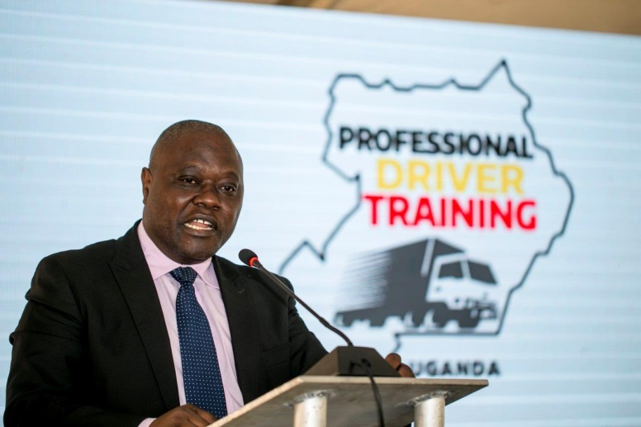
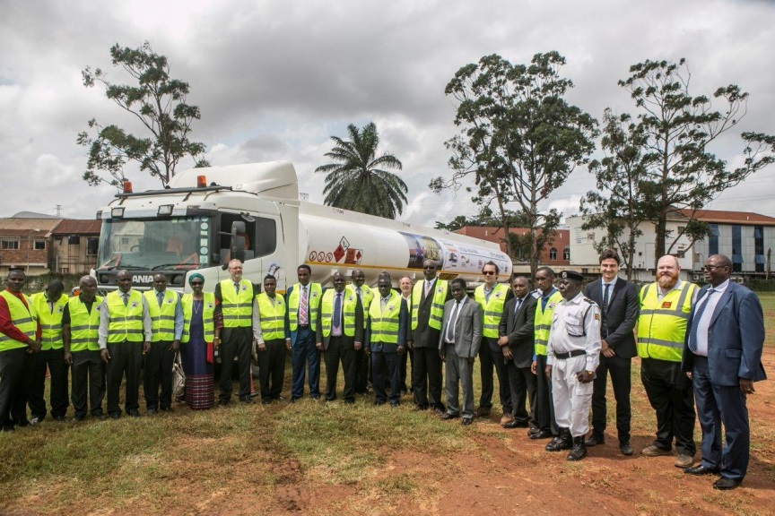
Launch of the project and stakeholder commitment
Strong support by Ministry of Works and Transport and Ministry of Energy and Mineral Development
Inclusion of employer and employee associations

Slide 15
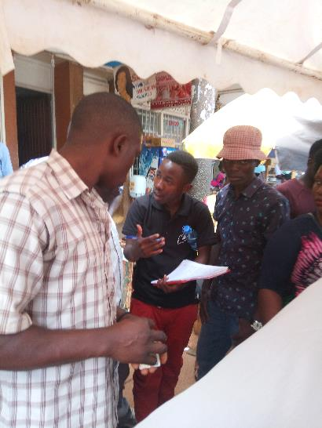
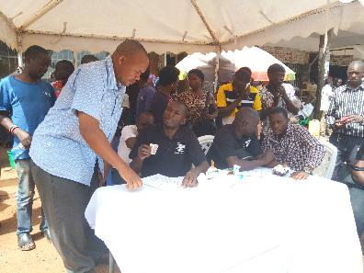
Outreach campaign and registering of individuals
By 29. August 2017 1567 individuals have registered their interest for licence aquistion / upgrade

Slide 16
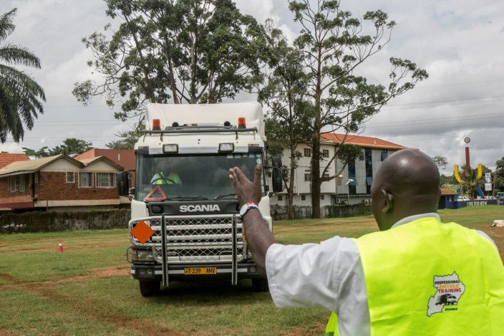
Plans for Driver Training at SWRW School
Driver training to start beginning of October
Jointly agreed fee structure: Licence Aquisition / Upgrade Programme: 990.000 UGX (~230€)
B2B/individual refresher trainings: 500.000 UGX (~125€)
Estimated target until end of 2017:
12 people trained for licence aquisition / upgrade
100 people trained in refresher trainings

Slide 17
Current Challenges
Currently, number of training vehicles constraint to raise the number of people trained
Demand seems to be higher than currently possible output
Keeping individuals interested due to possible long waiting time for training slot
Many individuals want to come for training while being on a job
Notes:
SWRW Board Members have communicated that they would potentially be willing to support with more trucks
Renault has registered interest in the project and might provide a truck for the training school from time to time
Scania is equally interested in the project

